Slide 1

W3C WoT Thing Description
Joint meeting with SDWG, 21 September 2016

Slide 2
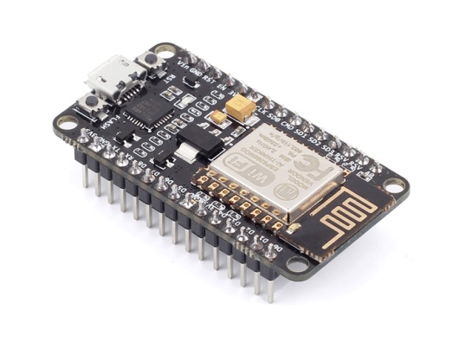
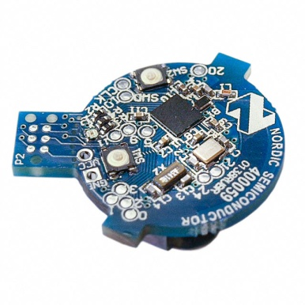
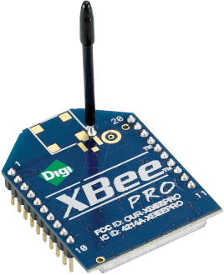
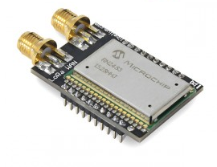

What is the Web of Things?
Application Layer
Internet of Things
: Connectivity
IEEE 802.15.4
Ethernet
Wi-Fi
Bluetooth
LoRa
…

Slide 3





What is the Web of Things?
Internet of Things
: Connectivity
IEEE 802.15.4
Ethernet
Wi-Fi
Bluetooth
LoRa
…

Slide 4
What is the Web of Things?
Web of Things: Applications
Internet of Things
: Connectivity
IEEE 802.15.4
Ethernet
Wi-Fi
Bluetooth
LoRa
…

Slide 5
W3C WoT Mission
Not to be yet another standard
Web of Things
…
“interconnecting existing Internet of Things platforms
and complementing available standards”

Slide 6
WoT Building Blocks
Scripting API:
Can consume remote Things through the Client API, local hardware and connected legacy devices through a Physical API (t.b.d.), and expose Things through the Server API. To allow portable app scripts, the Servient must povide a runtime environment.
WoT Servient
App Script
(Physic. API)
Discovery API
Client API
Server API
Runtime Environment
Thing Description (TD):
Declares WoT Interface for interaction and provides (semantic) metadata for the Thing. TD is used by WoT clients to instantiate local software object of the Thing.
Legacy comm-unication
Resource Model
Thing
Description
Protocol Bindings
Client Role
Server Role
Protocol Bindings:
Converts abstract interactions with Things to different protocols using the information from TD. The Resource Model provides a common abstraction with uniform interface. Like the Web, it allows to identify and address interaction points through URIs.
Proprietary interface
WoT Interface
Legacy
device
Web Server
Web Client
WoT Servient
WoT Servient

Slide 7
Thing Description
Need to Describe Heterogeneous Thing, Communication, and Security Metadata
http://w3c.github.io/wot/current-practices/
wot-practices.html#thing-description

Slide 8

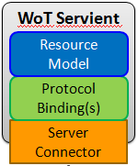
I Want to Use a Thing represented as a WoT Servient
Who are you?
What kind of data do you serve?
How can I access the data/function?
What kind of functions do you have?
What kind of protocols/encodings do you support?
Are there some security constrains?
→ W3C Thing Description (TD)

Slide 9
Thing Description
Describes Thing metadata and interactions
WoT Servient
WoT Servient
Resource
Model
Protocol
Binding(s)
Protocol
Binding(s)
Client Connector
Server
Connector

Slide 10
Thing Description
Describes Thing metadata and interaction
WoT Servient
WoT Servient
Thing
Description
Resource
Model
Protocol
Binding(s)
Protocol
Binding(s)
Client Connector
Server
Connector

Slide 11
Thing Description
Machine clients can understand WoT Interface
WoT Servient
WoT Servient
Metadata, URIs
Thing
Description
Resource
Model
Protocol
Binding(s)
Protocol
Binding(s)
Client Connector
Server
Connector

Slide 12
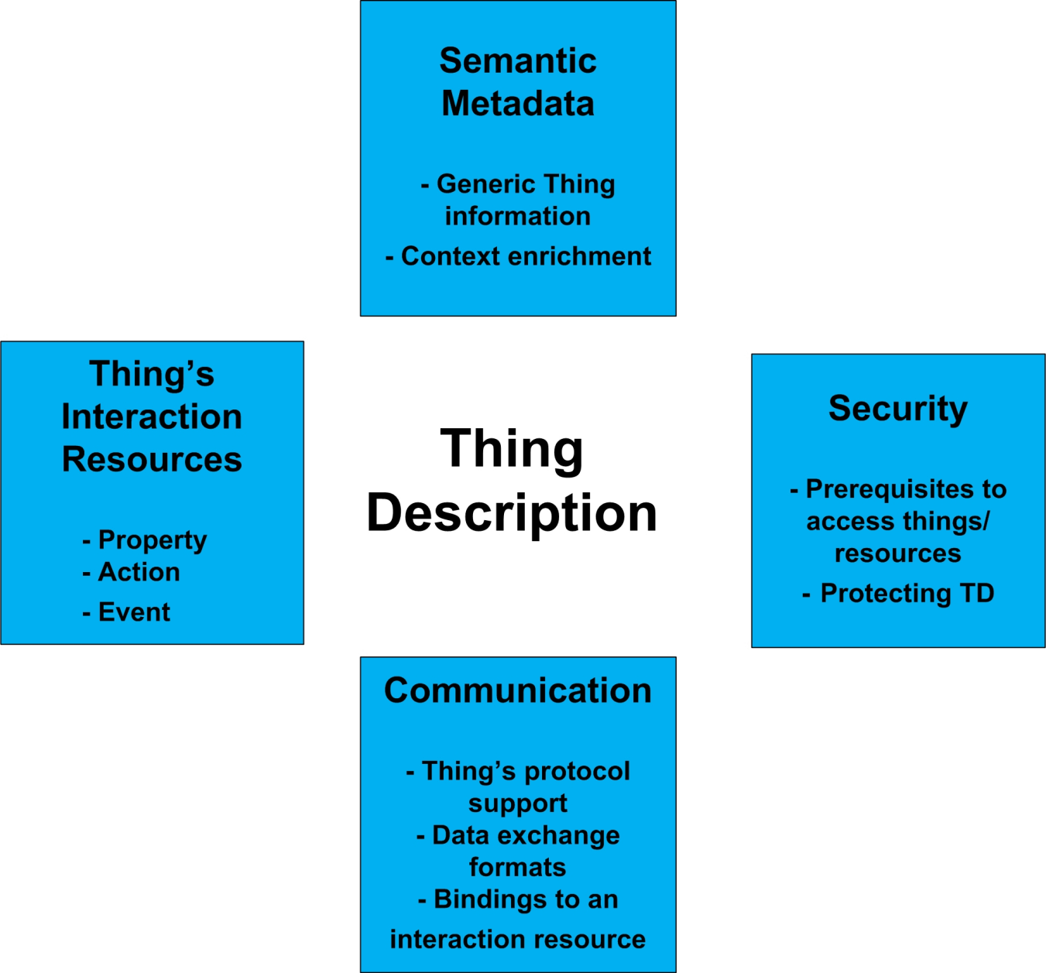
Aspects covered by Thing Description

Slide 13
Describe your Thing based on JSON-LD
Reach interoperability by a
semantic description language
  based on well established JSON format
  enables machine interoperability by using (standardized) vocabularies from given @context
JSON-LD is rooted in the RDF model
  subject, predicate, object triples

Slide 14
TD Example
coap://www.example.com:5683/temp
{
"@context": [ … ],
"@type": “Thing",
"name": "myTempSensor",
"uris": [ "coap://www.example.com:5683/temp" ],
"encodings": [ "JSON" ],
"properties": [{
"@id": "val",
"@type": "Temperature",
"unit": "celsius",
"name": "myTemp",
"valueType": { "type": "number" },
"writable": false,
"hrefs": [ "val" ]}],
“actions": [{
“inputData": {
valueType: { "type": "number" }},
"name": "myThermostat",
"hrefs": [ “set" ]}],
"events": [{
"valueType": { "type": "number" },
"name": "myWarning",
"hrefs": [ "val/high" ]}]
}
/.well-known/core
/temp
/temp/val
/temp/set
/temp/val/high

Slide 15
TD Example
coap://www.example.com:5683/temp
{
"@context": [ … ],
"@type": “Thing",
"name": "myTempSensor",
"uris": [ "coap://www.example.com:5683/temp" ],
"encodings": [ "JSON" ],
"properties": [{
"@id": "val",
"@type": "Temperature",
"unit": "celsius",
"name": "myTemp",
"valueType": { "type": "number" },
"writable": false,
"hrefs": [ "val" ]}],
“actions": [{
“inputData": {
valueType: { "type": "number" }},
"name": "myThermostat",
"hrefs": [ “set" ]}],
"events": [{
"valueType": { "type": "number" },
"name": "myWarning",
"hrefs": [ "val/high" ]}]
}
Property
Action
Event
Thing
Web Resource
Entity
proxyFor
Interaction
Proxy Resource
formalExactProxyFor
Thing Description
Semantic Resource

Slide 16
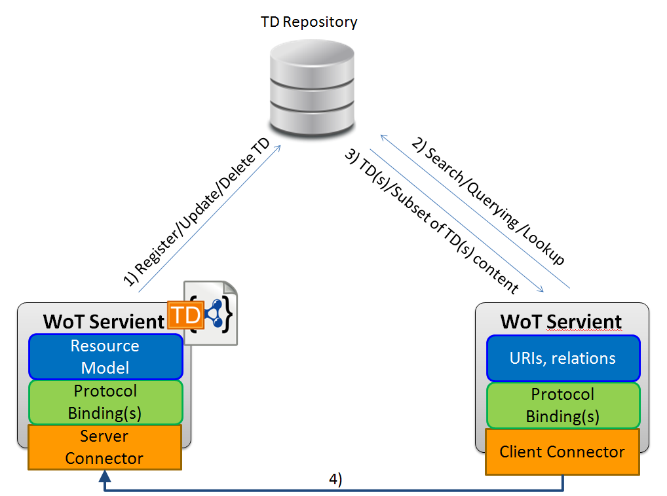
TD Repository
Register and discover appropriate TDs

Slide 17
Extending Thing Description with Other Semantic Models
Application Models
Domain Dependent Models
(e.g., SAREF)
- Semantic enrichment
- Domain dependency
Domain Independent Models
(e.g., SSN, QUDT)
Thing Description

Slide 18
Extending Thing Description with Other Semantic Models
(DUL)
Quality
Abstract
(DUL)
Property
Action
(SSN)
Property
Command
(SAREF)
(QUDT)
Quantity Kind
Temperature
Pressure
Quantity of Light
Step Up Command
Start Command
Toggle Command
Open Command
Toggle Functionality

Slide 19
Extending Thing Description with Other Semantic Models
coap://www.example.com:5683/temp
{
"@context": [ …, {“saref”: “https://w3id.org/saref”}],
"@type": ["Thing", “saref:TemperatureSensor"],
"name": "myTempSensor",
"uris": [ "coap://www.example.com:5683/temp" ],
"encodings": [ "JSON" ],
"properties": [{
"@id": “_:val",
"@type": [“saref:multiLevelSate”],
"name": "myTemp",
"valueType": { "type": "number" },
"writable": false,
"hrefs": [ "val" ]}],
“actions": [{
"@type": “saref:SetAbsoluteLevelCommand",
“inputData": {
valueType: {
"type": "number",
"@type": “saref:Temperature"}},
"name": "myThermostat",
"hrefs": [ “set" ],
“saref:actsUpon”: “_val”}],
"events": [{
"valueType": { "type": "number" },
"name": "myWarning",
"hrefs": [ "val/high" ]}]
}

Slide 20
Extending Thing Description with Other Semantic Models
Script to look for windows in the same room and close them:
WoT.discover("repository", {
repository: "http://localhost:8080",
query: "?t a saref:Switch ; saref:isUsedFor ?bo ; hasAction ?a ; isLocatedIn " + room + " . " +
"?bo a saref:Window . " +
"?a a saref:CloseCommand ."
}).then(function(things) {
things.forEach(function(thing) {
var name = thing.actions.find(function(t) { return t["@type"] === "saref:CloseCommand" }).name;
thing.invokeAction(name);
});
})

Slide 21
Online Resources
Interest Group
  https://www.w3.org/WoT/IG/
  https://lists.w3.org/Archives/Public/public-wot-ig/ (subscribe to mailing list)
Documents (for implementers)
  http://w3c.github.io/wot/architecture/wot-architecture.html
  http://w3c.github.io/wot/current-practices/wot-practices.html (living document)
  Beijing 2016 Release:
  http://w3c.github.io/wot/current-practices/wot-practices-beijing-2016.html
GitHub (documents and proposals)
  https://github.com/w3c/wot
Wiki (organizational information: WebConf calls, Face-to-Face meetings, …)
  https://www.w3.org/WoT/IG/wiki/Main_Page
WoT Projects (implementing WoT Current Practices)
  https://github.com/thingweb/
  https://github.com/mkovatsc/wot-demo-devices
  Please add yours!

Slide 22
Thank You
More information available at:
https://w3c.github.io/wot/current-practices/wot-practices-beijing-2016.html#thing-description

