Slide 1
Digital Offers: Schema.org
Discussion points, June 2017
David Ezell (NACS)
V1.0

Slide 2
Schema.org Introduction
Vocabularies cover
  entities,
  relationships between entities, and
  actions.
Google, Microsoft, Yahoo and Yandex
GitHub and public-schemaorg@w3.org

Slide 3
Schema.org/Offer
An offer to transfer some rights to an item or to provide a service — for example, an offer to sell tickets to an event, to rent the DVD of a movie, to stream a TV show over the internet, to repair a motorcycle, or to loan a book.

Slide 4
Schema.org: Example
<script type="application/ld+json">
{
"@context": "http://schema.org",
"@type": "Event",
"location": {
"@type": "Place",
"address": {
"@type": "PostalAddress",
"addressLocality": "Denver",
"addressRegion": "CO",
"postalCode": "80209",
"streetAddress": "7 S. Broadway"
},
"name": "The Hi-Dive"
},
"name": "Typhoon with Radiation City",
"offers": {
"@type": "Offer",
"price": "13.00",
"priceCurrency": "USD",
"url": "http://www.ticketfly.com/purchase/309433"
},
"startDate": "2013-09-14T21:30"
}
</script>

Slide 5
Discussion
In what portions of DO work is a data model required?
Is a data model required for work on web standards?
Should the DO CG consider adopting the schema.org work?
If so, should we model that work on ISO8583 TG-23?

Slide 6
Thank You

Slide 7
Additional Slides

Slide 8

ISO8583 TG-23

Slide 9
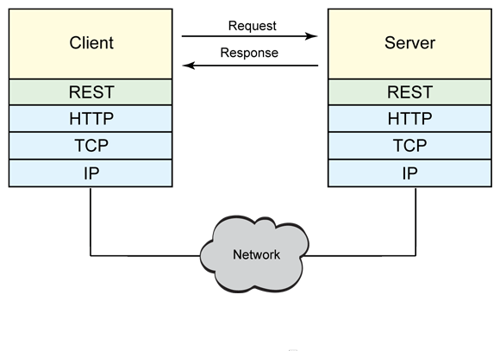
RESTful Web Service

Slide 10


Didn’t we have APIs before?
Yes… but HATEOAS (hypermedia as the engine of application state) gives feedback
on “what comes next”!
Hints!
Hypermedia indicates ………………………………………………….. what to do next!

Slide 11
A more relevant HATEOAS example…
Client
Request
Server
GET /account/12345 HTTP/1.1
HTTP/1.1 200 OK
<?xml version="1.0"?>
<account>
<account_number>12345</account_number>
<balance currency="usd">100.00</balance>
<link rel="deposit" href="/account/12345/deposit" />
<link rel="withdraw" href="/account/12345/withdraw" />
<link rel="transfer" href="/account/12345/transfer" />
<link rel="close" href="/account/12345/close" />
</account>
Response
Or…
GET /account/12345 HTTP/1.1
HTTP/1.1 200 OK
<?xml version="1.0"?>
<account>
<account_number>12345</account_number>
<balance currency="usd">-25.00</balance>
<link rel="deposit" href="/account/12345/deposit" />
</account>
Response

