Slide 1
Web Cryptography & Utilizing ARM TrustZone® based TEE for Authentication & Cryptography
Ilhan Gurel
September 10th & 11th, 2014

Slide 2


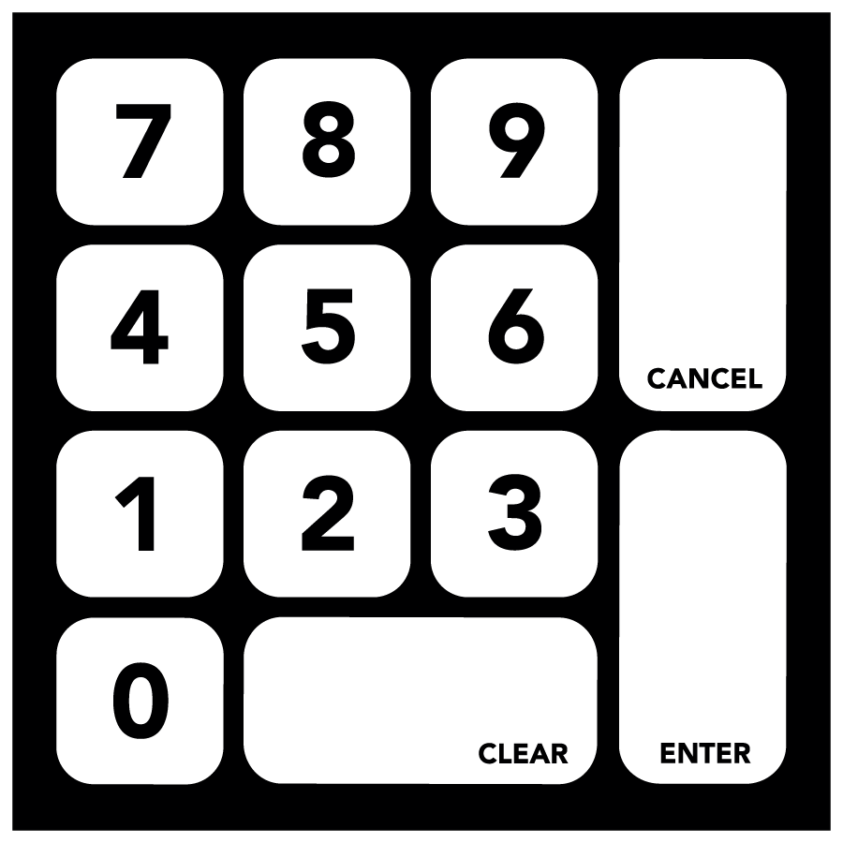


Why use a TEE?
Key assets exposed
Key assets protected
SMART CONNECTED DEVICE
Normal App
TEE Enabled App (e.g. Web Apps)
Isolated space for handling high value assets
Trusted App
Security Critical Assets
API Call on
Security critical
Routine
Trusted App - Secured
Critical Assets
OPERATING SYSTEM
TEE
ARM TrustZone® enabled
SoC

Slide 3
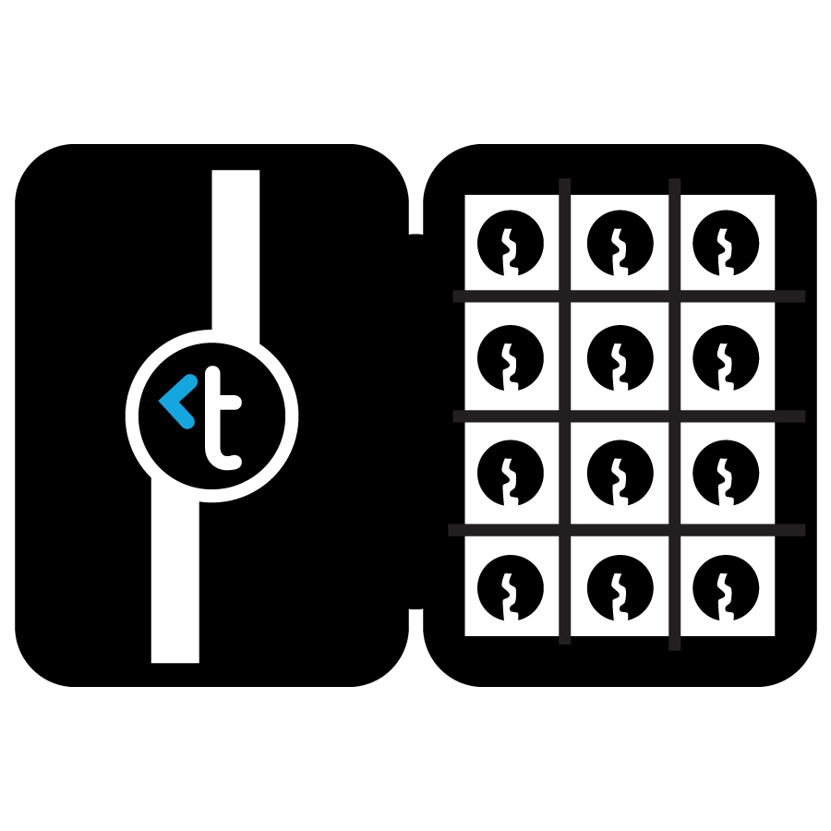


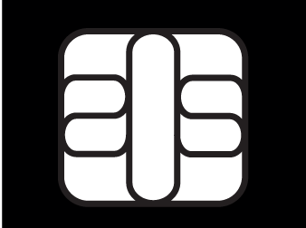
Where does a TEE fit?
Interfaces | FULL |  | FULL |  | FULL ACCESS AS NEEDED |  | RESTRICTED
Processing Power | HIGH |  | HIGH |  | HIGH |  | LIMITED
Assurance | LOW |  | LOW |  | HIGH |  | HIGH
Attack Resistance | LOW |  | MEDIUM |  | HIGH to Software and Hardware |  | HIGH to Physical Tampering
Access Control | LOW |  | LOW |  | HIGH |  | HIGH
SMART CONNECTED DEVICE
OPERATING
SYSTEM
OPERATING
SYSTEM + AV
HYPERVISOR
TEE
SMART CARD OS
ARM TrustZone®
enabled
SoC
SECURE ELEMENT

Slide 4
TEE Uses Cases
DRM (Digital Rights Management)
Trusted UI
Authentication
  Certificate based authentication, OTP,..
  Handling biometric peripherals, storing and processing biometric data securely
Integrity Protection & Measurement
Crypto and key management
  Secure key derivation, random data generation.
  Secure access to crypto HW accelerator
  Crypto operations
  Encapsulation of key material as well as sensitive data to ensure confidentiality and integrity
Secure storage, rollback protection and more..

Slide 5
Android KitKat Keymaster as an example
Android KitKat keymaster utilizes TEE for crypto operations and key management
  RSA, DSA and ECDSA algorithms supported
  Key generation, sign, verify, import key data, get public key operations
TEE specific HW module can be installed and it allows using TEE applications for the required functionality
Abstract APIs
Isolation of key material between client applications

Slide 6
Trustonic’s position
ARM TrustZone® based TEE solutions
  allow easy and cost effective deployment of TEE applications
  already available on millions of devices (Trustonic TEE solutions is currently running on ~250 million device the number is growing)
  also spreading to desktops and laptops with the adoption of ARMv8 based SoCs and ARM based AMD platform security processor (PSP) technology
  already being used for various uses cases as described earlier

Slide 7
Trustonic’s position (cont’d)
The solution to be adopted by W3C should
  be based on the use of standard JavaScript APIs and/or HTML tags
  have abstraction layer for low level implementations that allows the usage of TEE/SE modules
  allow Web applications to chose and use TEE/SE applications for crypto operations, key management as well as authentication
  allow checking and installing TEE/SE applications from Web applications

